Slide 1
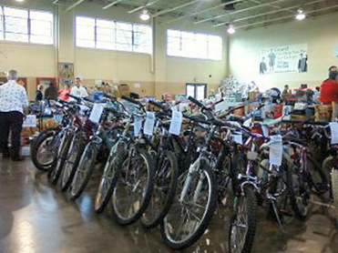

2013 Tau Beta Pi Bike Drive
Why: Recycle bikes for The Christian Help Annual Christmas Toy Drive
When: Nov. 11 – Dec. 12
What: Bicycles, bike parts, new helmets, or donations by PayPal to donate@positivespin.org
Drop-off Locations:
Engineering Sciences Building loading dock (near Freshman Engineering entrance)
Positive Spin - (803 E Brockway Ave.)
Habitat for Humanity Restore - (251 Don Knotts Blvd.)
Call, email, or visit website for Positive Spin shop openings at
304-276-0213
info@positivespin.org
www.positivespin.org

