Slide 1
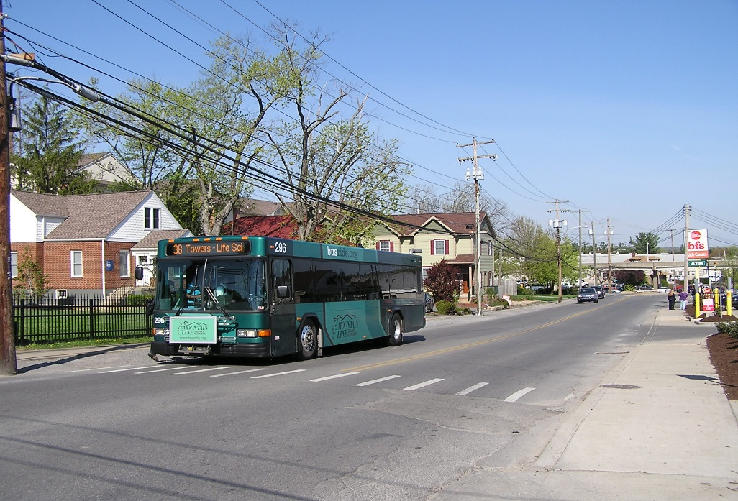
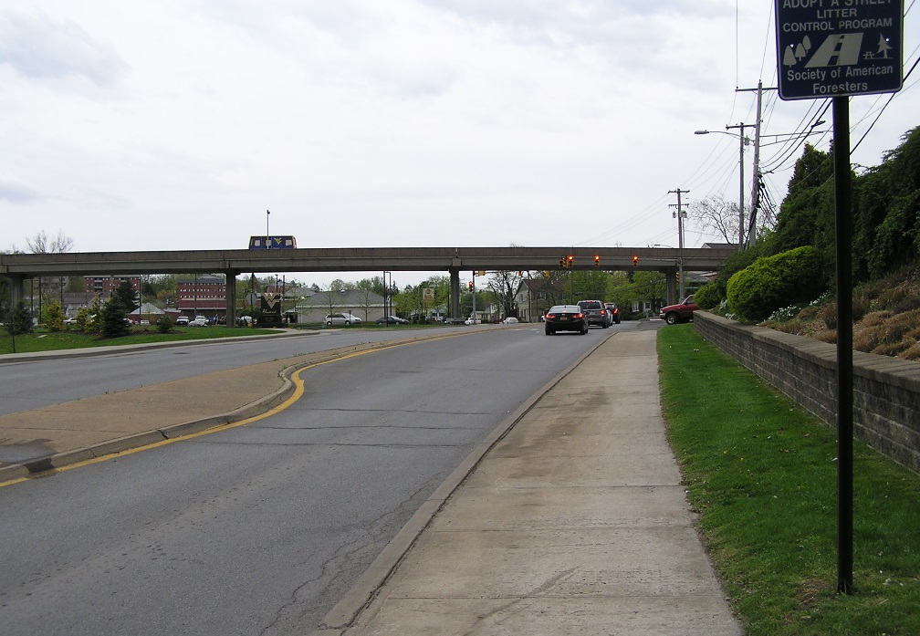
University Avenue Corridor Study
City of Morgantown
Presented to:
The Morgantown Traffic Commission
May 7, 2014
Presented by:
Robert Goetz, P.E. Trans Associates

Slide 2
Purpose of Study
Determine potential improvements to enhance the safety & mobility of:
    Vehicles
    Pedestrians
    Transit
    Bicycles
  Based on existing & future demand
  Develop opinions of probable cost to implement improvements
University Avenue Corridor Study City of Morgantown

Slide 3
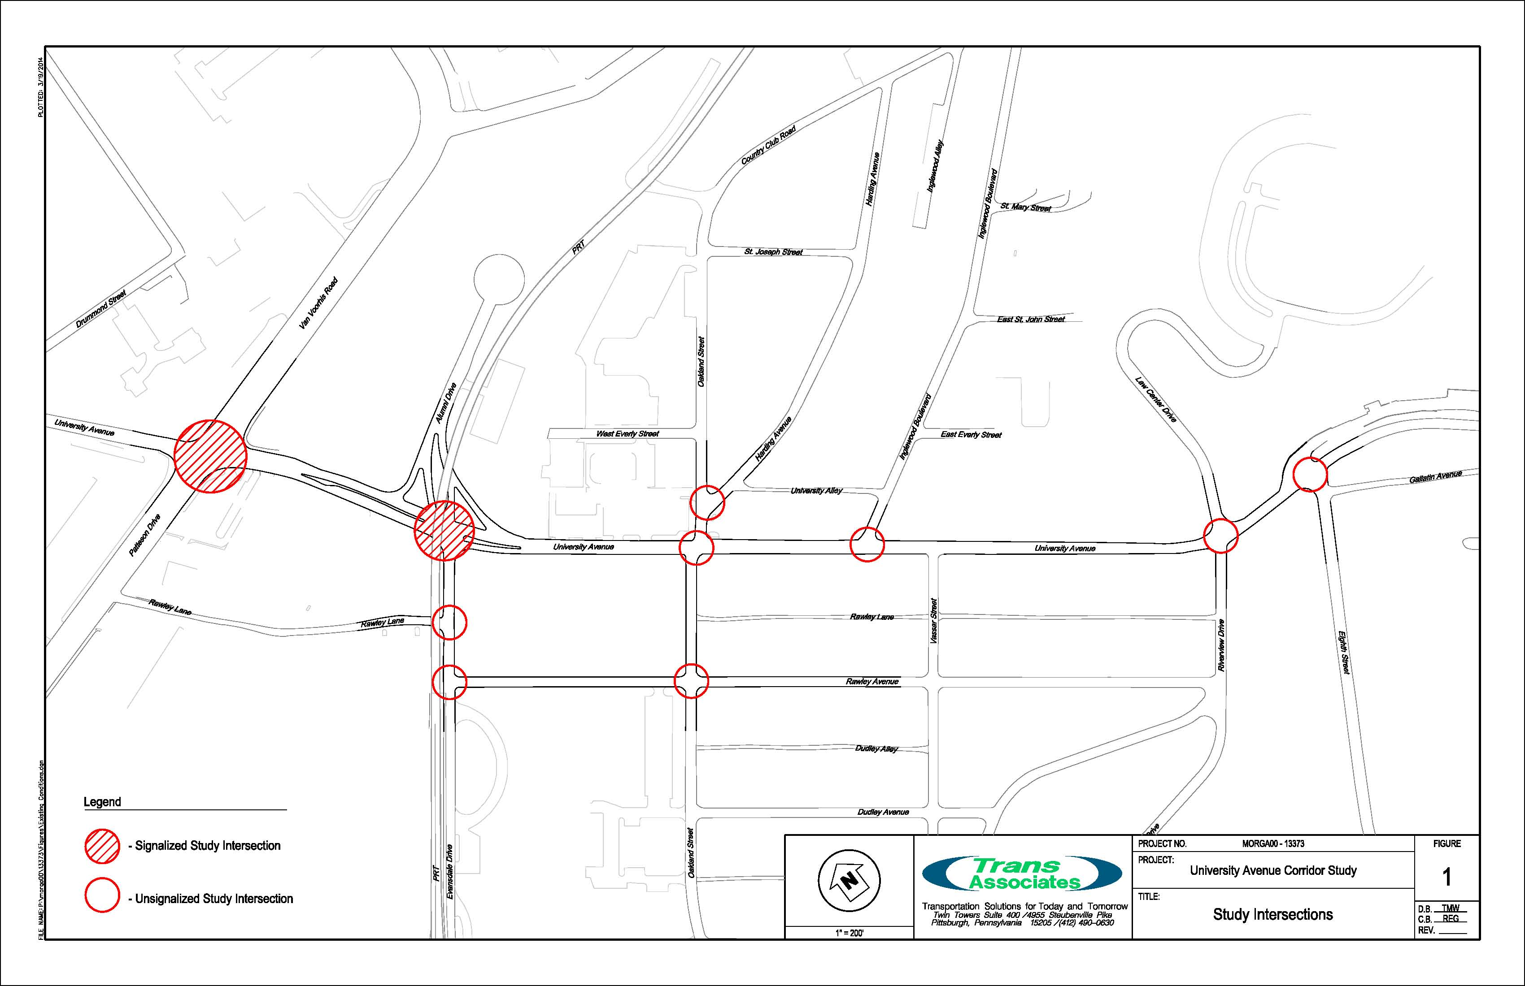
Study Area
University Avenue between Patteson Drive & Eighth Street
Included 10 intersections, Rawley Avenue, Evansdale Drive
University Avenue Corridor Study City of Morgantown

Slide 4
Data Collection
Traffic counts at study intersections performed in April 2013, January and March 2014
All counts performed when WVU was in session
Counts included, cars, trucks, buses & pedestrians
Due to Evansdale Drive closure, counts from WVU study were used
According to MMMPO University Avenue in the study area has an AADT of 15,980 to 18,180
Information gathered on street widths, speed limits, traffic control & signal timings
University Avenue Corridor Study City of Morgantown

Slide 5
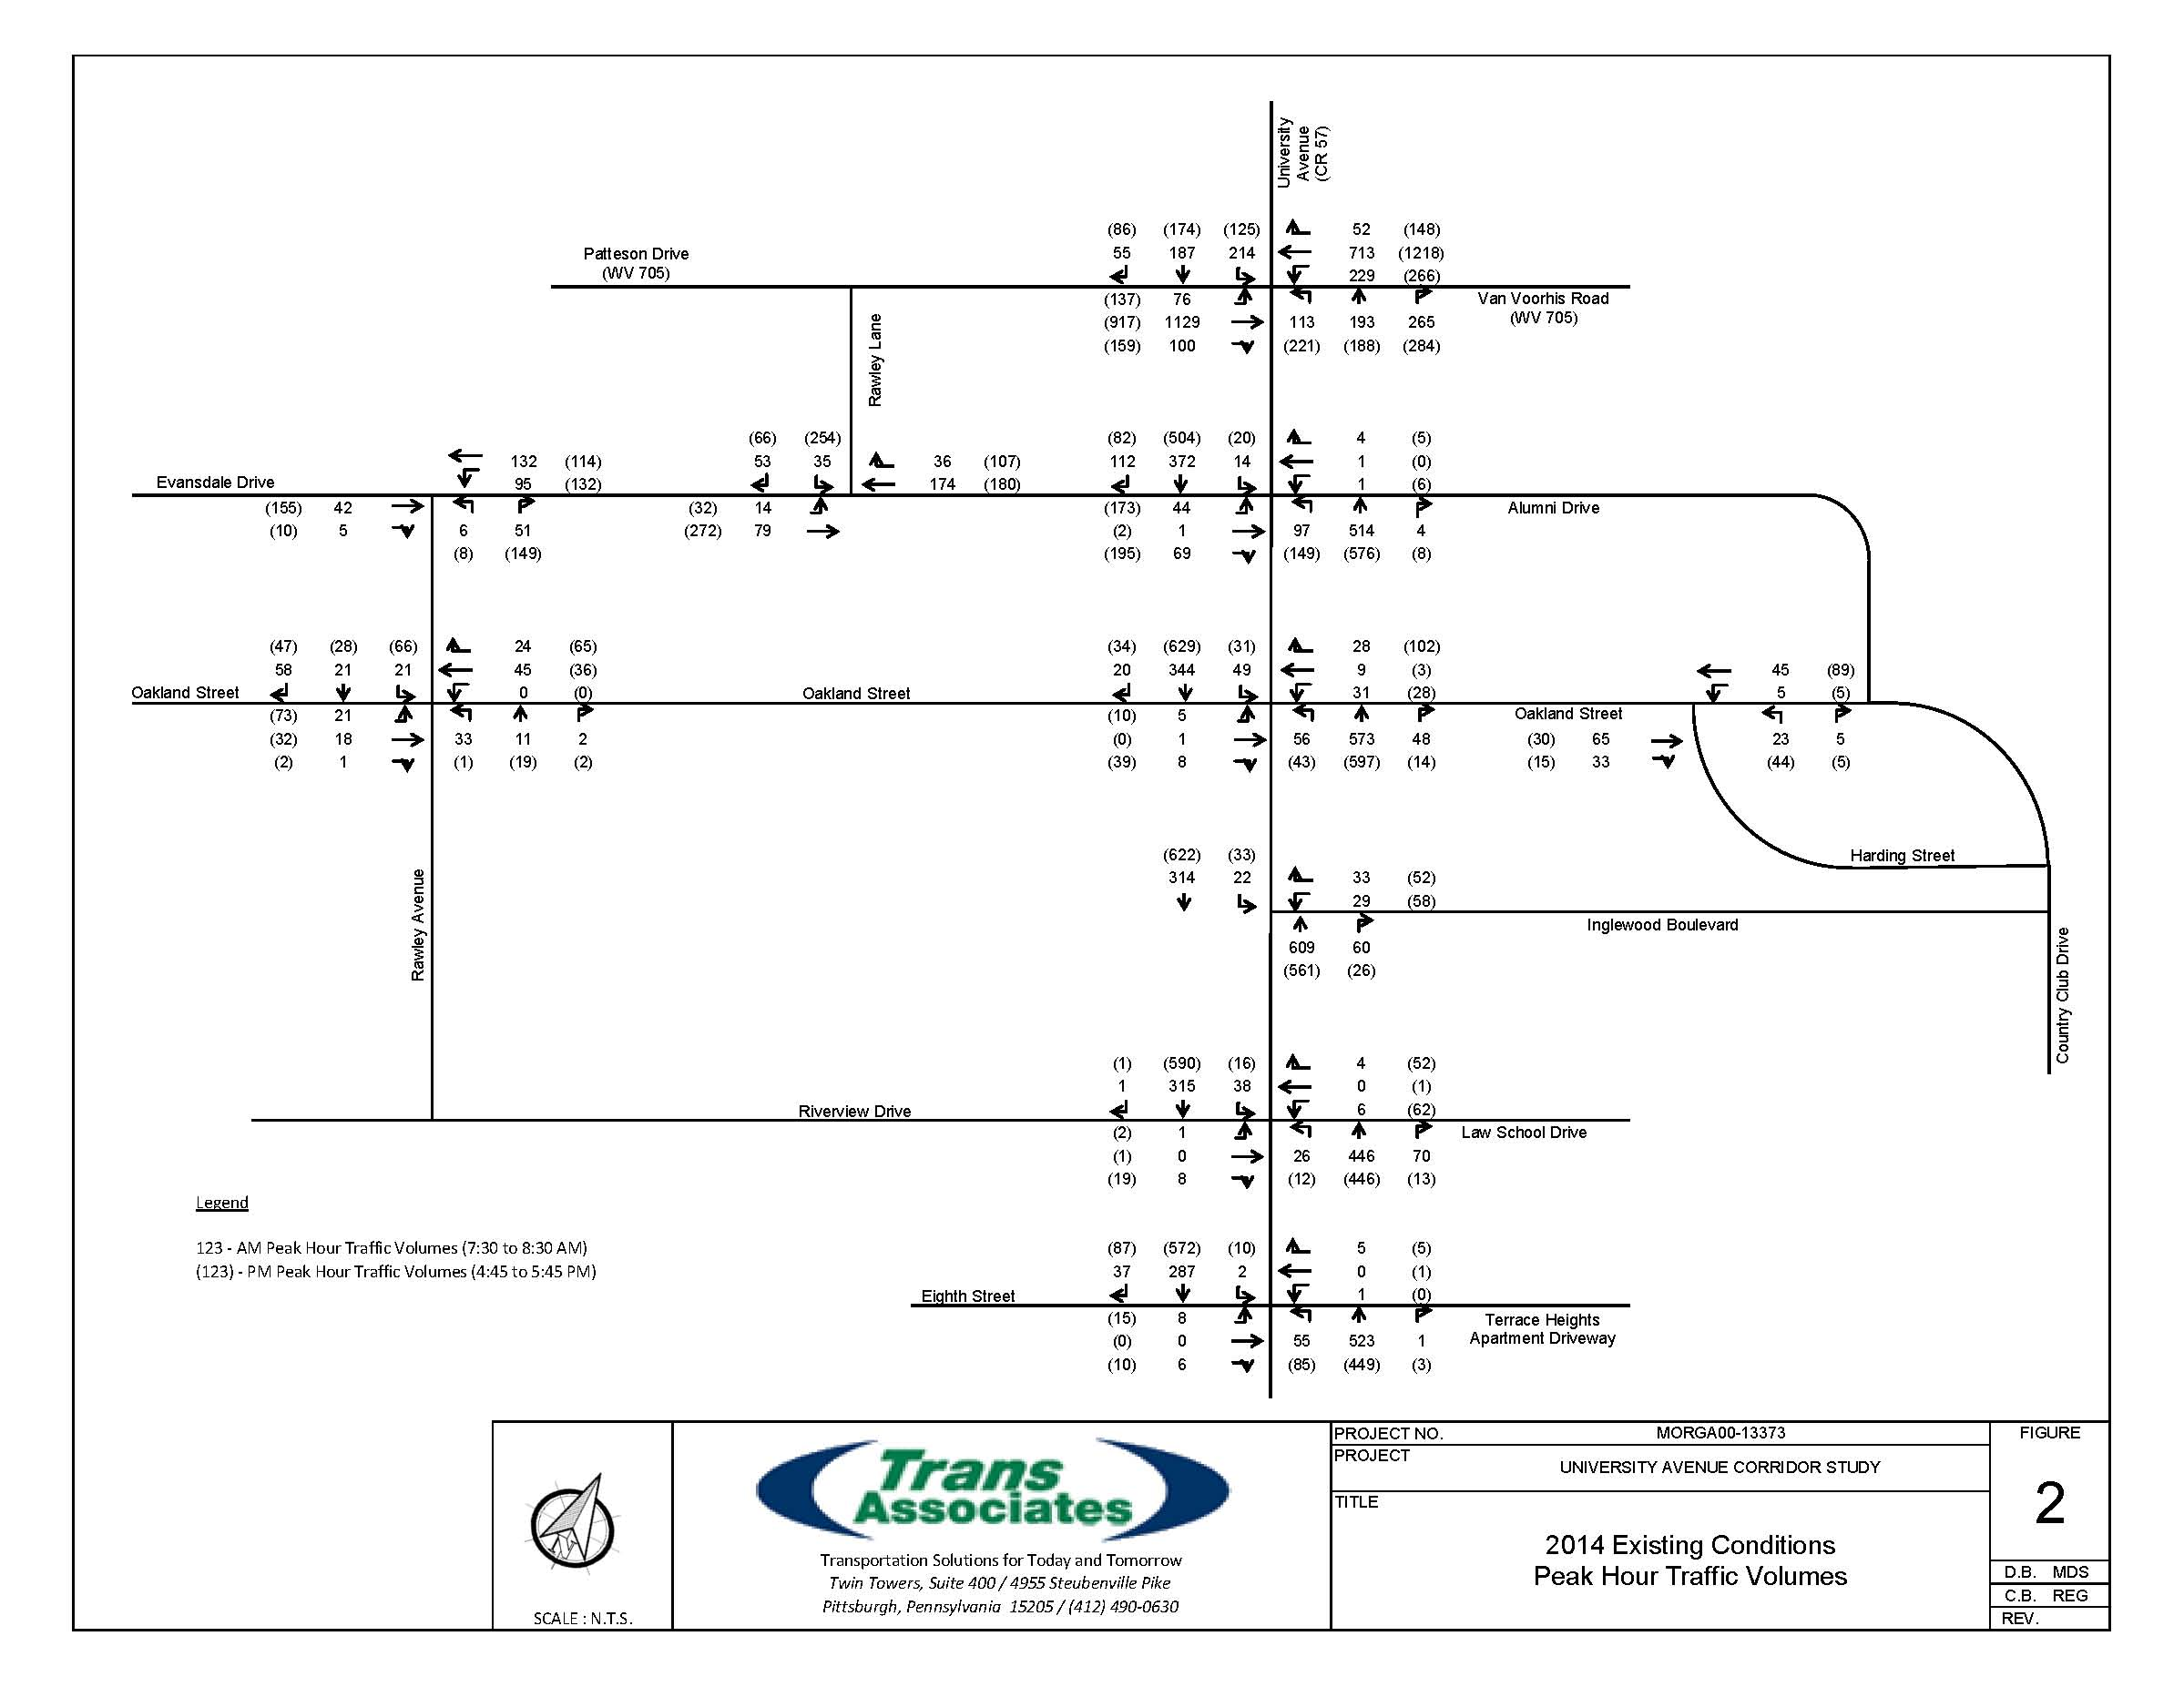
Existing Weekday AM / PM Peak Hour Volumes
University Avenue Corridor Study City of Morgantown

Slide 6
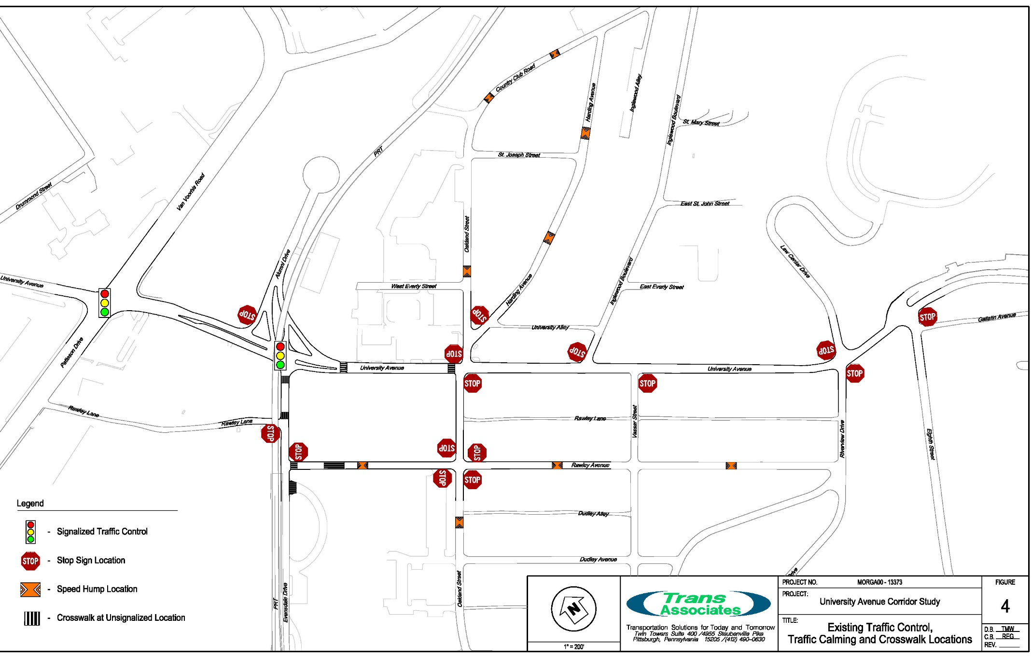
Existing Traffic Control
University Avenue Corridor Study City of Morgantown

Slide 7
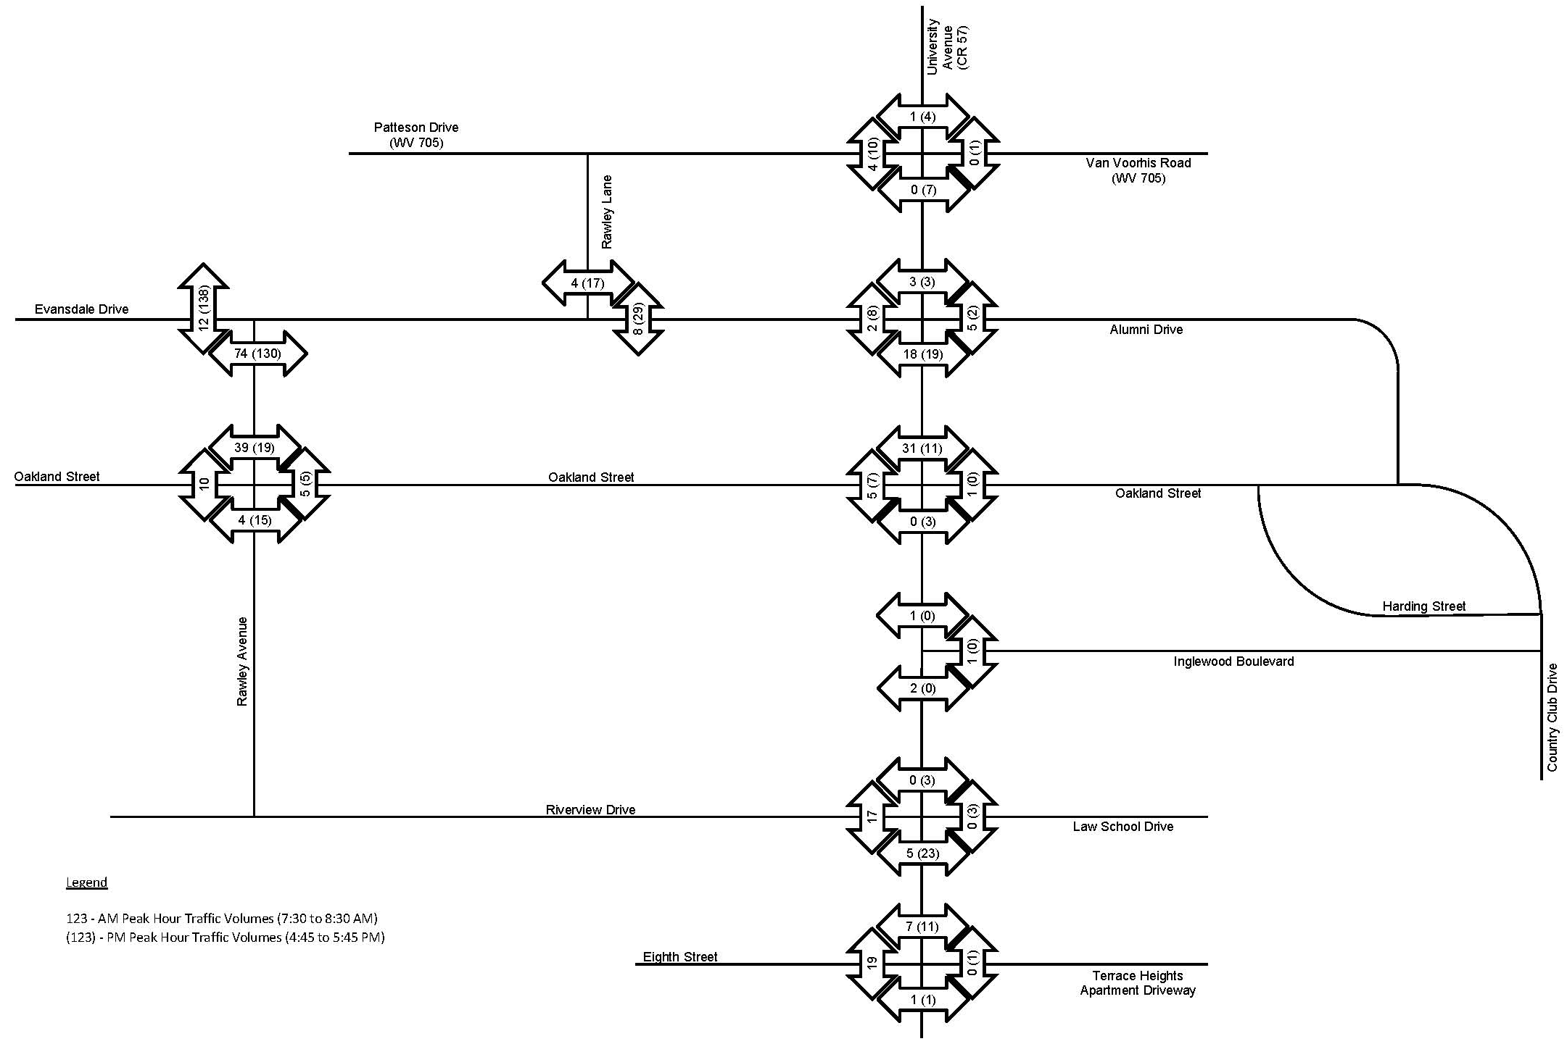
Pedestrian Volumes
University Avenue Corridor Study City of Morgantown

Slide 8
Existing Conditions Analysis
  Level of Service (LOS) per Highway Capacity Manual
    Based on delay to motorist
    LOS A (best) to LOS F (failure)
    LOS D considered minimum for urban area
    Oakland St approaches to University Ave: LOS F in AM/PM
    Law School driveway & Eighth St approaches: LOS F in PM
    Significant queues for WB/SB lefts at Patteson Dr/University Ave
    Significant queue for WB Oakland Ave at University Ave
    Volumes currently warrant signal at Oakland Street
University Avenue Corridor Study City of Morgantown

Slide 9
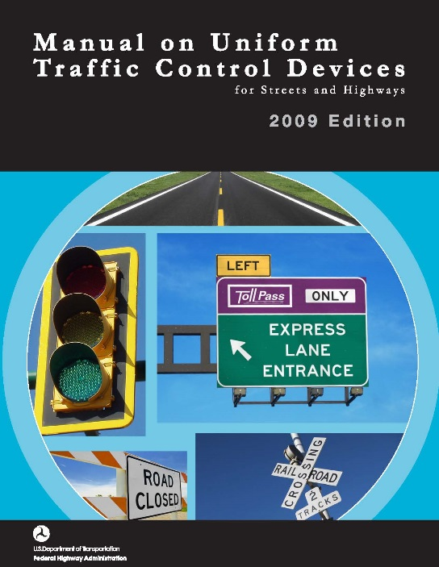
MUTCD Signal Warrants
  FHWA Manual on Uniform Traffic Control Devices (MUTCD) establishes criteria for 9 warrants
  Most warrants based on meeting minimum volumes on intersecting streets during
  specified hours
  Typically, criteria for only one warrant
  needed satisfied to justify signal installation
  University Ave & Oakland St satisfies:
    Warrant 1.B Interruption of Continuous Traffic (8 hours)
    Warrant 2 Four Hour Vehicular Volume
    Warrant 3 Peak Hour
    University Ave & Law School drive not satsified
University Avenue Corridor Study City of Morgantown

Slide 10
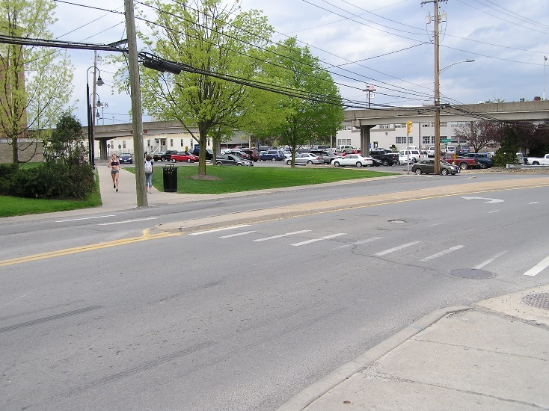
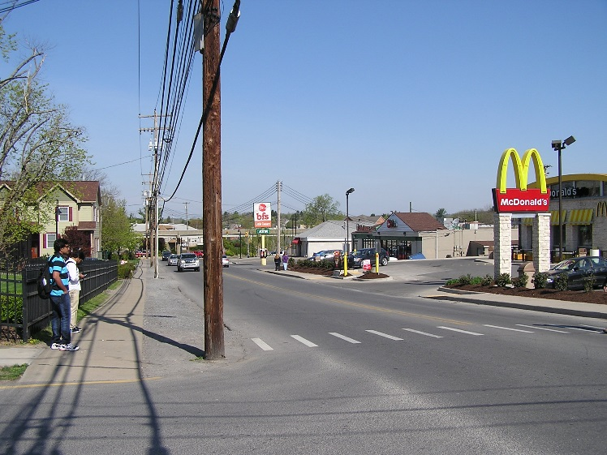
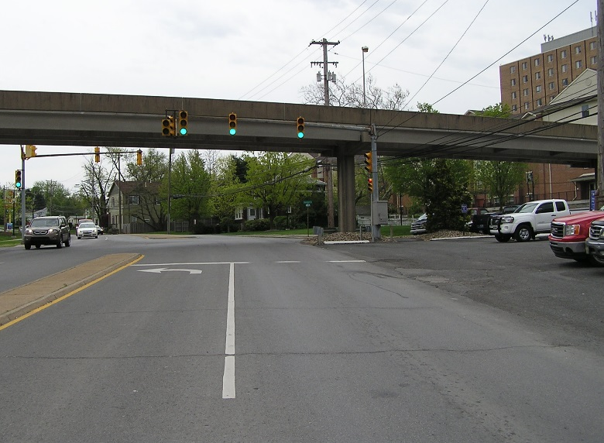
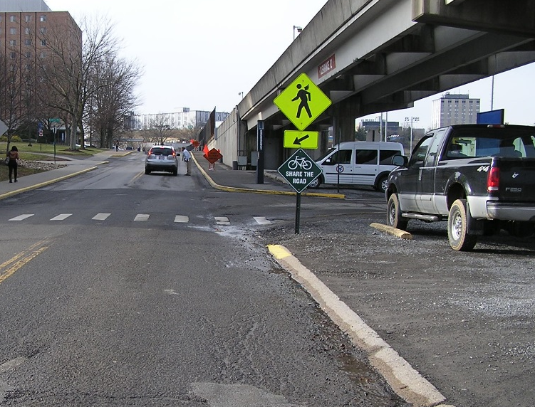
Additional Existing Conditions Issues
Unexpected Crosswalk Location
Crosswalk Protection
Condition of Signal
Parking Along University Ave
Sidewalk Continuity
University Avenue Corridor Study City of Morgantown

Slide 11
Projected Traffic Volumes & Conditions
Projects that will significantly affect traffic in the corridor over next several years:
  University Park – 1,300 bed student residential development to access Oakland Street
  WVU Evansdale Crossing – bookstore, restaurant, office, classroom space on Evansdale Campus
  WVU Hospitals Medical Center Drive Relocation – concurrent with Ruby Memorial Tower construction
University Avenue Corridor Study City of Morgantown

Slide 12
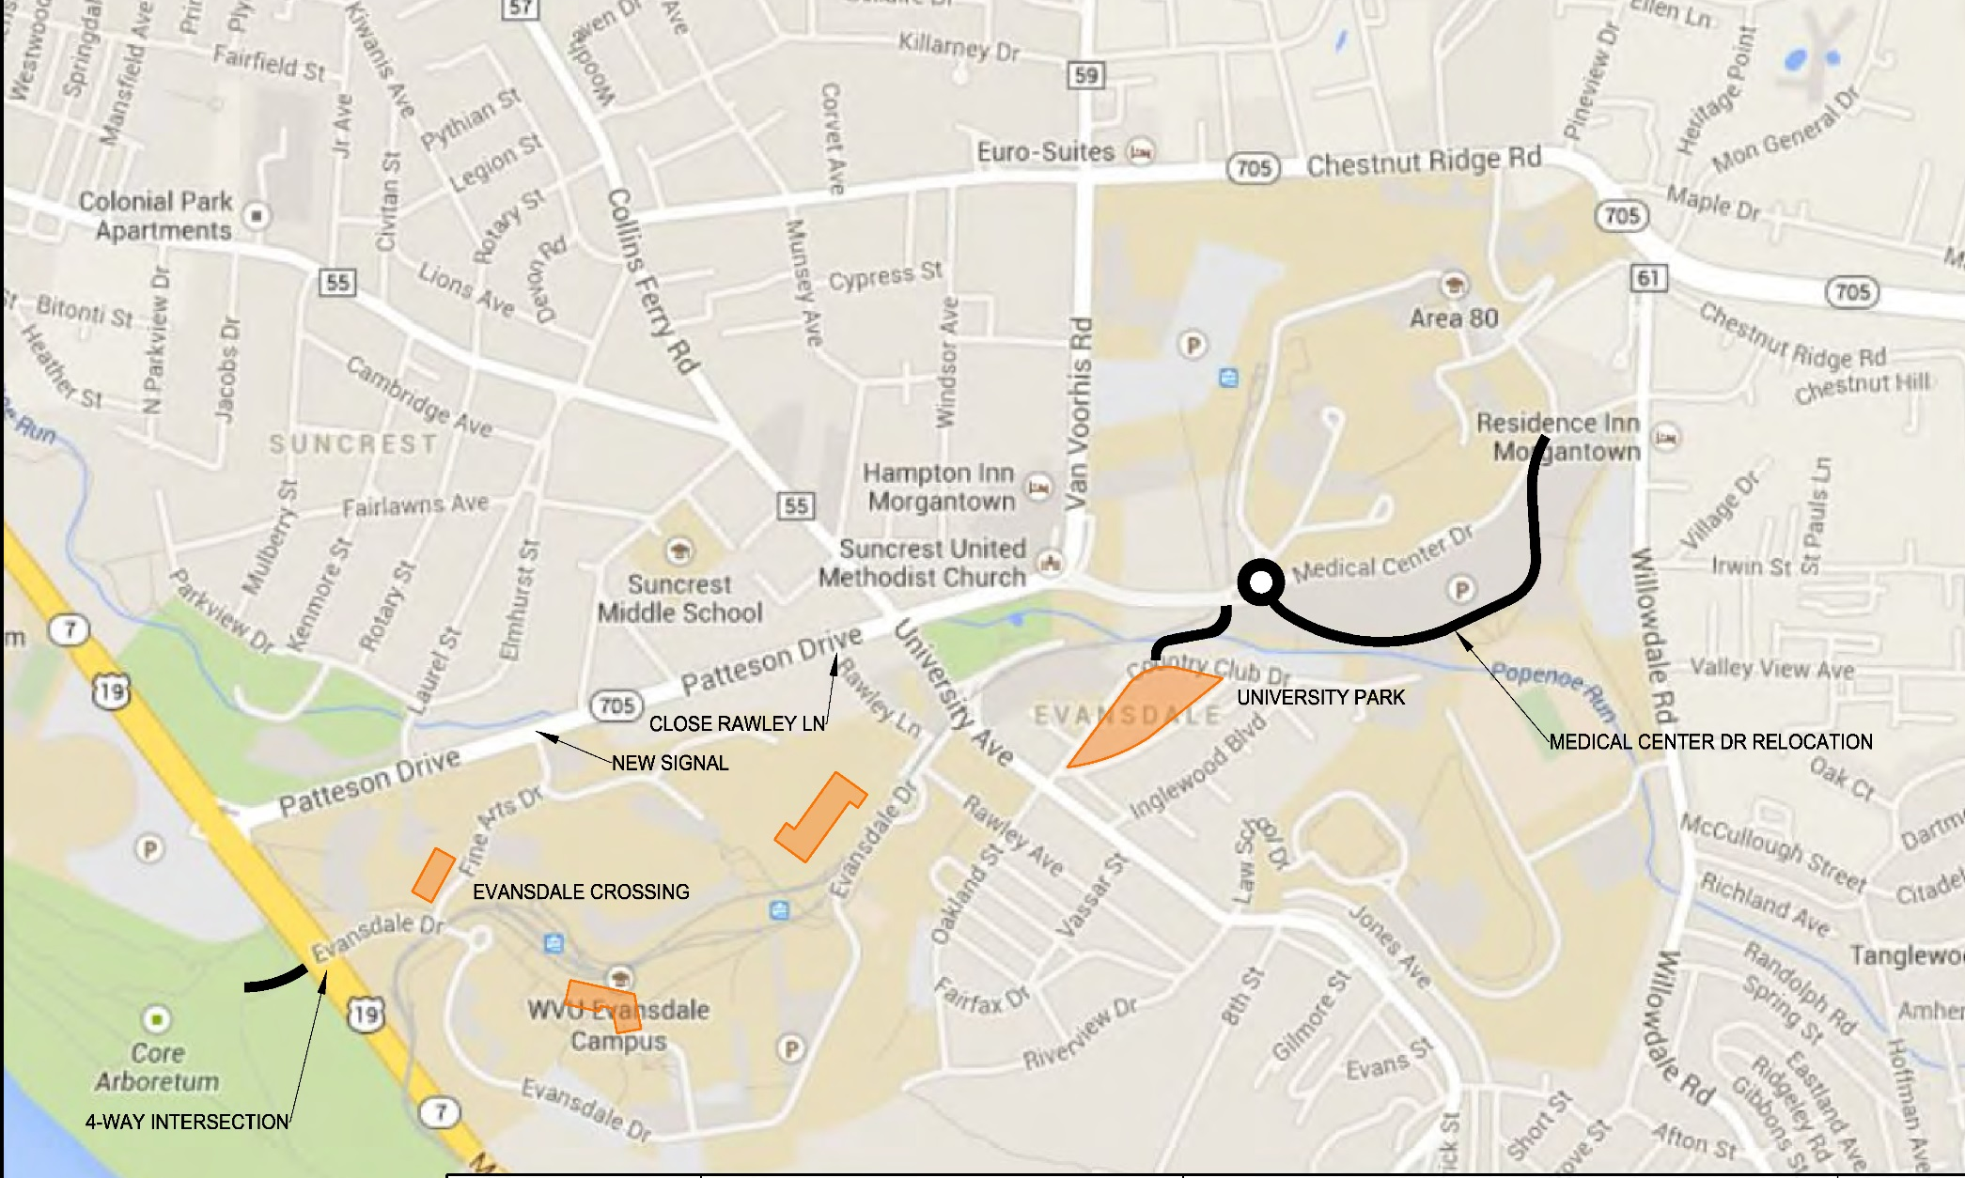
Project Locations
University Avenue Corridor Study City of Morgantown

Slide 13
Projected Conditions Traffic Analysis
Patteson Drive/University Ave deteriorates to LOS F
Additional delay at University Ave/Evansdale Drive
Significant additional delay to Oakland Street (currently meets signal warrants)
Additional delay on Law School driveway and Eighth Street (do not satisfy warrants for signalization)
Alternate analysis assumed closure of Evansdale Drive west of Towers. Signal warrants still satisfied at Evansdale Drive.
University Avenue Corridor Study City of Morgantown

Slide 14
Conclusions
Proposed developments will have significant impacts to the University Avenue corridor
A signal is presently warranted at University Avenue & Oakland Street
A signal is still needed at University Avenue & Evansdale Drive even if Evansdale is closed at Towers
A signal is not warranted at either the Law School or Eighth Street
Better pedestrian accommodations (sidewalk continuity, protected crosswalks) are needed
A designated share the road on lower volume streets would be helpful for bicycles
University Avenue Corridor Study City of Morgantown

Slide 15
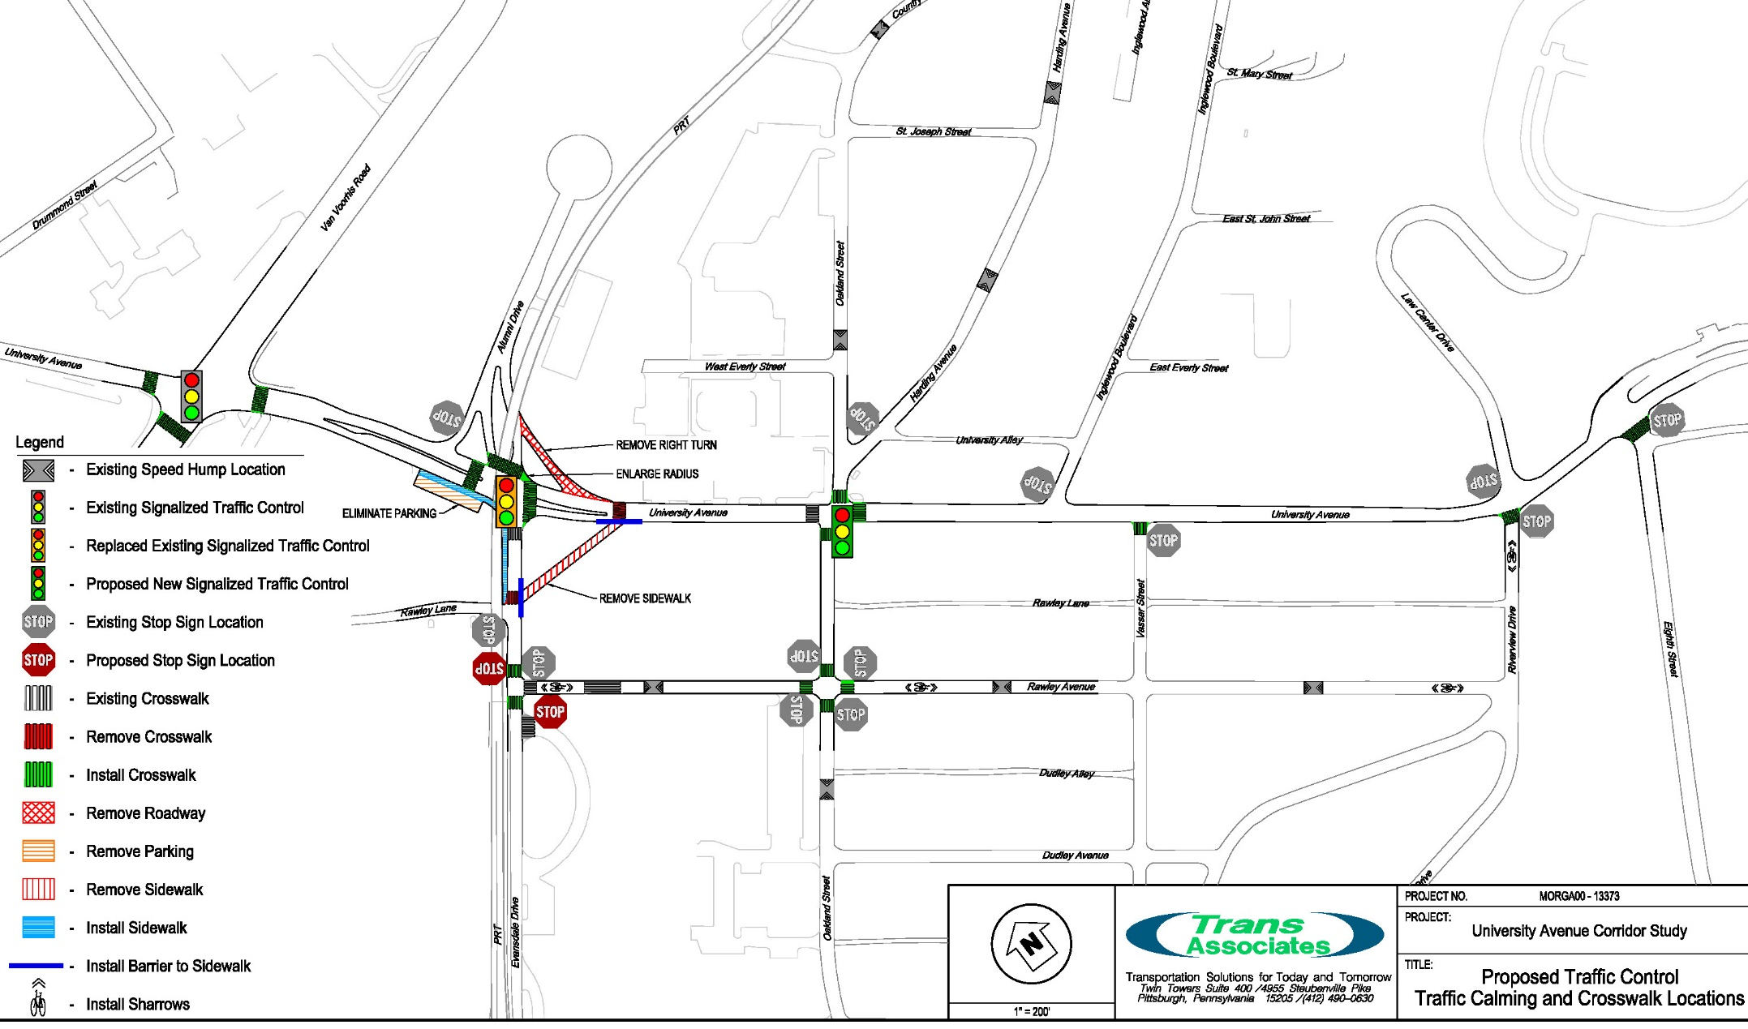
Recommendations
University Avenue Corridor Study City of Morgantown

Slide 16
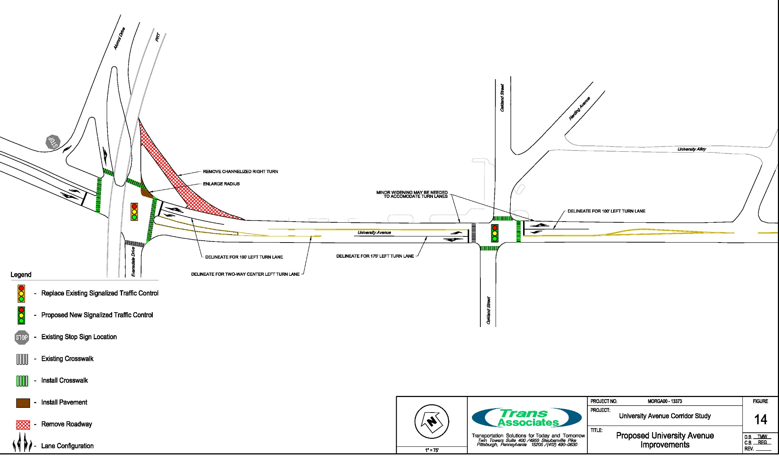
Recommendations (continued)
University Avenue Corridor Study City of Morgantown

Slide 17
Opinions of Probable Cost
  Replace signal at Evansdale Dr/Alumni Dr: $223,000
  Install new signal at Oakland Street: $199,000
  Provide left turn lanes along University Dr between Evansdale Dr & Oakland St: $96,000
  Eliminate channelized right into Alumni Dr: $40,000
  Install curb/sidewalk along WVU Maintenance lots: $37,000
  Add crosswalk markings at 7 intersections: $14,000
  Eliminate crosswalks, provide access control: $11,000
  Designate Rawley Ave / Riverview Dr “Share the Road”: $11,000
  Provide right turn signal for NB University Ave at 705: $5,000
University Avenue Corridor Study City of Morgantown

Slide 18
Thank you
Questions
& Answers
University Avenue Corridor Study City of Morgantown

